Slide 1

HABIT
Healthy Actionable Behavioral-based Information Technology
Terps pour Santé

Slide 2








Terps pour Santé Members
Keyur Shah
MS Information Systems
Robert H. Smith School of Business
keyur.shah@rhsmith.umd.edu
Deok Gun Park
PhD Computer Science
UMD Department of Computer Science
intuino@umd.edu
Chun Wong
MBA Healthcare Information Systems
MS Information Systems
Robert H. Smith School of Business
chun.wong@rhsmitih.umd.edu
Tejal Kanase
MS Information Systems
Robert H. Smith School of Business
tejal.kanase@rhsmith.umd.edu
Ishwarya Sethuraman
MS Information Systems
Robert H. Smith School of Business
ishwarya.sethuraman@rhsmith.umd.edu
Luis Santos
PhD Mechanical Engineering
A. James Clark School of Engineering
santosl@umd.edu
Kenyon Crowley, Mentor
PhD Information Science
UMD iSchool
Deputy Director, CHIDS
kcrowley@rhsmith.umd.edu
Notes:
Luis Santos
Ishwarya Sethuraman
Tejal Kanase
Keyur Shah
Deok Gun Park
Chun Wong
Mentor: Kenyon Crowley

Slide 3
Problem
Massive amounts of health data available, small fraction actionable, difficult to gain insights.
Public health stakeholders
need better information and targeting strategies
Behaviors that influence health understood, but not well managed
Notes:
Imagine this:
Dr. Jane, MD, head of the public health department of the state of maryland
One of her mandates is to promote and encourage healthy behaviors and to help close health disparities
She’s in the Executive MBA at the smith school of business, she’s taken some data analytics courses
- Really comfortable and savvy with digging deep into the data to find insights but there are so much noise in the data, hard to find usable signals.

Slide 4
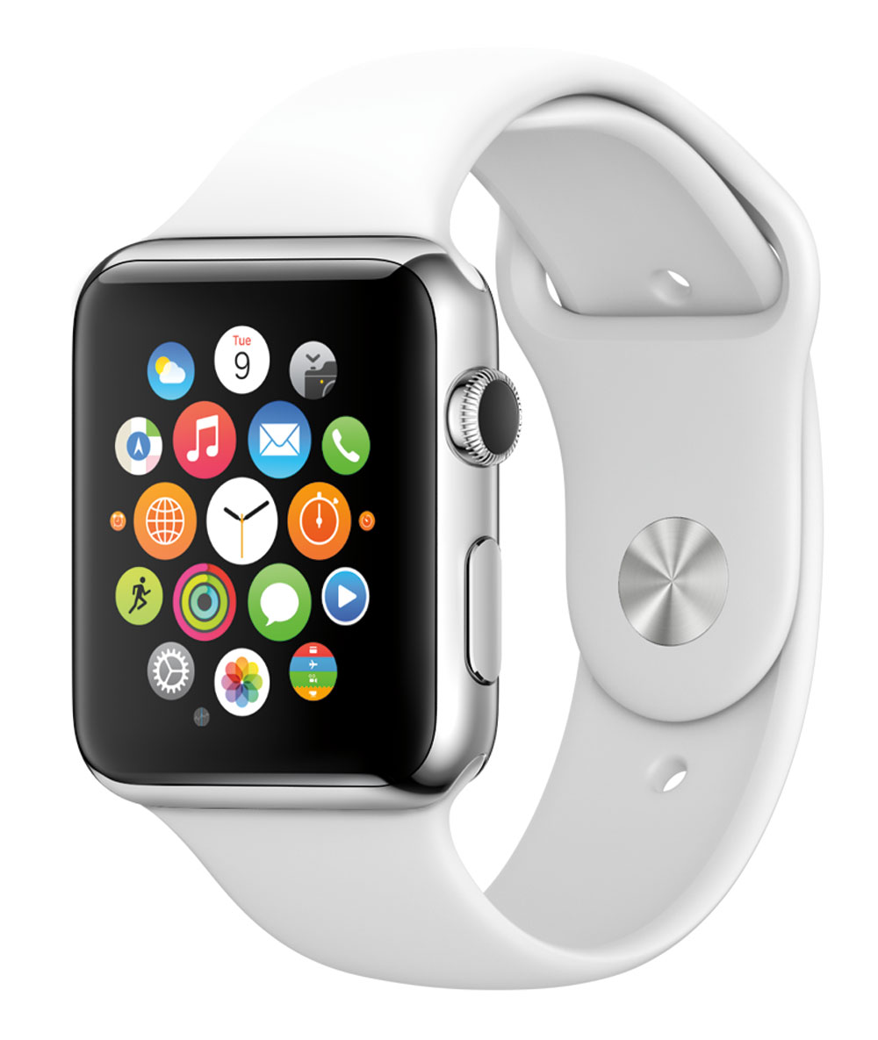
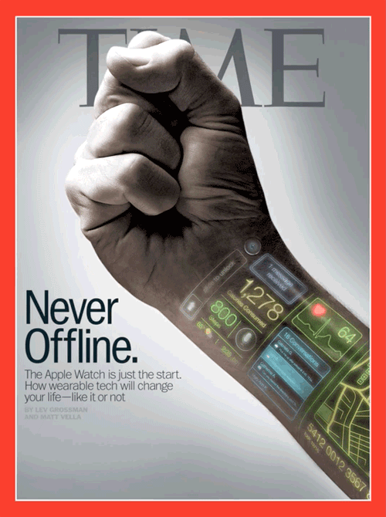
Opportunity
Proliferation of consumer wearable devices and mobile health apps
Evidence mixed, but emerging evidence of effectiveness
New tools and techniques
Improving sentiment towards wearables
PwC Survey
46 % believe technology will lower obesity rates
42 % believe the athletic ability will improve
21 % of US consumers own a wearable product
Data suggest wearables combined with geospatial data and analytic tools enables improved person and population health management
Social analytics across health departments and other public health stakeholders
Notes:
Consumers are getting more comfortable and familiar with wearable devices
Sentiment is improving
Geospatial data tied with wearable technology presents a huge opportunity for population health management

Slide 5

Objectives
Help public health and population health practitioners, decision makers and researchers to:
Gain quick insights into the massive volume of data
Know which datasets and data dimensions are most useful
Inform public and other stakeholders
Motivate wellness
Image: NIH BD2K
Notes:
What Dr. Jane needs is something
- to help her transform this big data into actionable information and knowledge
To help her gain some insights into various population health factors
And to prioritize population segments for intervention

Slide 6
Benefits
For the public health agency:
Improve quality, increase efficiency, save money
Quickly comb through terabytes of data to find spatial and temporal trends
Data-driven targeting of interventions
For the population health researcher:
Easy to use tools
To drill-down onto specific population segments, prioritize importance of health factors, etc.
Easily consolidate data
Interfaces to integrate data from multiple sources, thanks to partners like Validic.
Notes:
- But since dr jane’s department doesn’t have unlimited funds, she has to be very selective in the types and targets of the interventions, campaigns, or incentive programs.

Slide 7


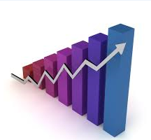
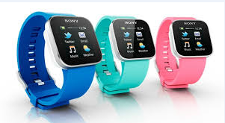


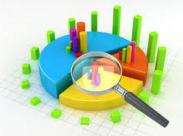


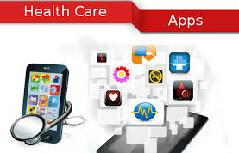
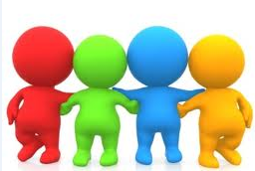


HABIT
Healthy habits Benchmarks
Health Surveys
HABIT
Analytics
Data
Healthy habits trend
Wearable Devices
Alerts for decline in trends
EHR
Users
Campaign Success Analysis
Mobile Application
University
Corporates
Communities
Hospitals
Public Health Agencies

Slide 8
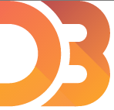


The Platform
Real-time, spatial overview of data
Comparative spatial analysis
Dynamic Data Manipulator
Prioritization of health factors
Real-time sorting, ranking, and visualizations
Validic Data Explorer
More scientific analysis, again real-time
Notes:
Good news.
From her APHA friends, Dr. Jane heard about this innovative solution, HABIT, from the 2014 apha codeathon
She knows that real-time comparative spatial analysis, dynamic data manipulation, and the innovative gatherplot can help provide huge insights into the population she serves, the citizens of maryland.
Go over primary HABIT components, especially Validic Data Explorer

Slide 9
Demo

Slide 10
Let’s get hands dirty, together
Habit1.firebaseapp.com
Habit2.firebaseapp.com
Habit3.firebaseapp.com

Slide 11

Expected Outcomes
Decrease in disease burden
Enhanced policy-making and resource allocation
Contribution to evidence base on how to create community wellness using wearable, behavioral, environmental and other data
Notes:
With the insights dr jane discovered from HABIT, she is confident in positive outcomes for the good people of maryland.
She continues to track the health of the population through HABIT.

Slide 12
Future Work
Optimizing efficacy of specific population-level interventions
Social analytics and prescription of data-driven strategies for public health departments
Share insights and discoveries with fellow public health agencies and researchers
Notes:
In the future, with more time, and a beneficial collaboration with the developers of HABIT
dr jane provides expert input into developing additional features so that all may benefit.

Slide 13
References
Hughes, Graham, MD. "How Big Is 'big Data' in Healthcare?" A Shot in the Arm. SAS, 21 Oct. 2011. Web. 15 Nov. 2014. <http://blogs.sas.com/content/hls/2011/10/21/how-big-is-big-data-in-healthcare/>.
“About BD2K” NIH Big Data to Knowledge (B2DK). Web. 15 Nov. 2014. <http://bd2k.nih.gov/about_bd2k.html>.
“Health wearables: Early days” New HealthEconomy. PricewaterhouseCoopers, 15 Nov. 2014. <http://www.pwc.se/sv_SE/se/halso-sjukvard/assets/health-wearables-early-days.pdf>.

